Slide 1
Econ 200 Module 2 Lecture 6

Slide 2
Outline
Changes in Surplus
Deadweight Loss
Why intervene?
Readings covered: Ch 5.5-5.8 & Appendix

Slide 3
How Can We Relate Surplus to Efficiency?
Two ways of defining Economic Efficiency:
A market is efficient if all trades take place where the marginal benefit equals or exceeds the marginal cost, and no other trades take place.
A market is efficient if it maximizes the sum of consumer and producer surplus (i.e. the total net benefit to consumers and firms), known as the economic surplus or total welfare.

Slide 4
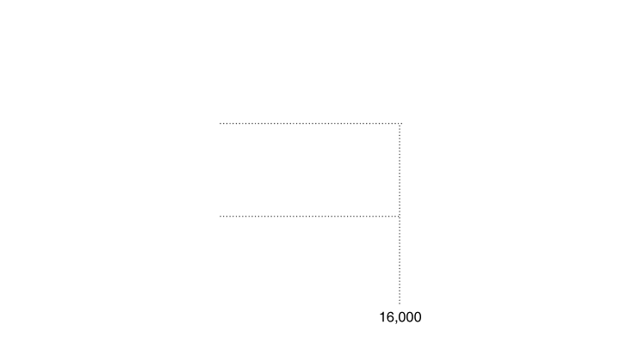
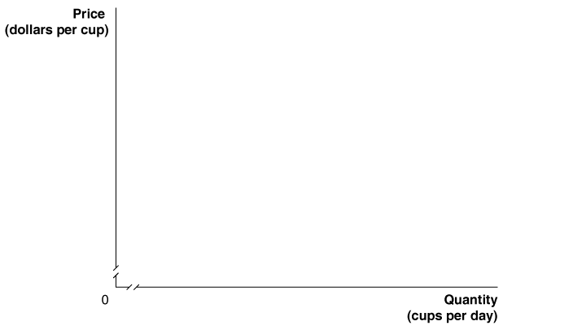
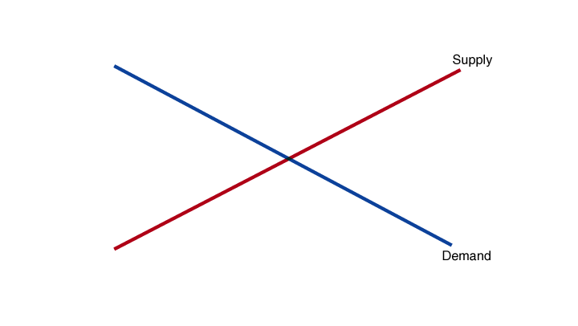
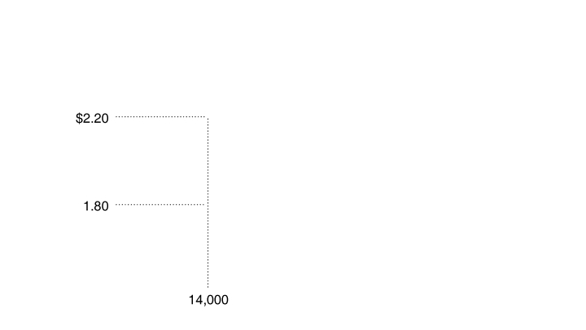
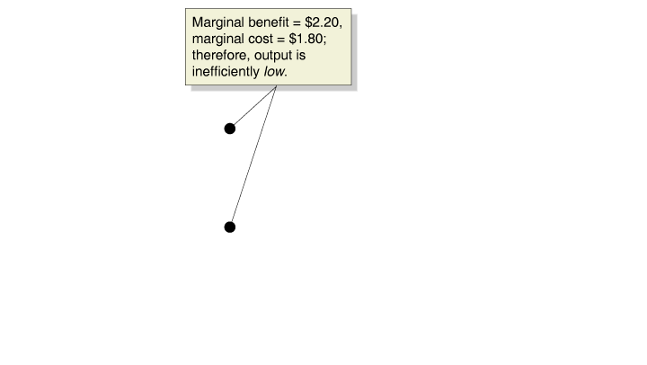
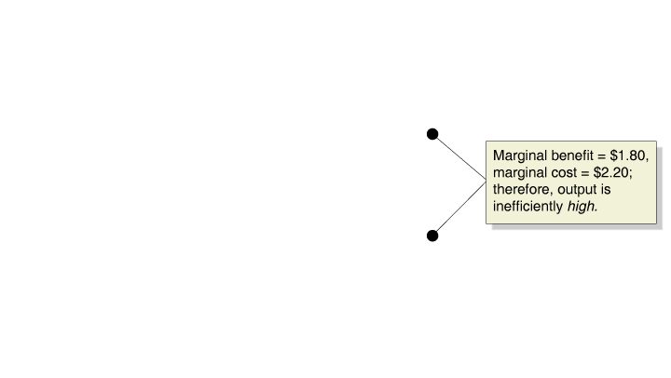
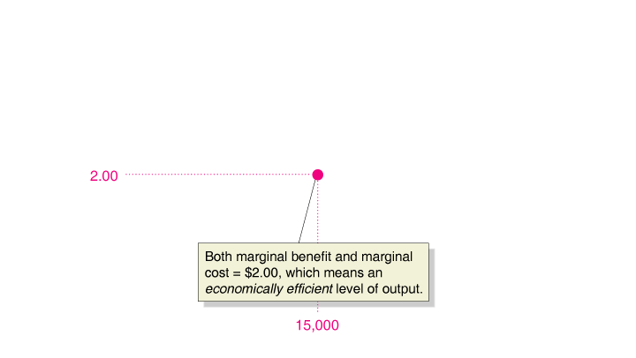
The Efficiency of Competitive Equilibrium
Demand: Marginal Benefit of each cup
Supply: Marginal Cost of each cup
If Q too low →MB>MC
If Q too high → MB<MC
Only at the competitive equilibrium is the last unit valued by consumers and producers equally—economic efficiency.
Notes:
In a competitive market, equilibrium occurs
at a quantity of 15,000 cups and a price
of $2.00 per cup, where marginal benefit
equals marginal cost. This level of output
is economically efficient because every cup
has been produced for which the marginal
benefit to buyers is greater than or equal to
the marginal cost to producers.

Slide 5

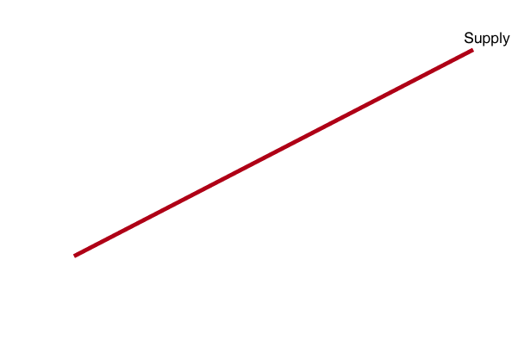

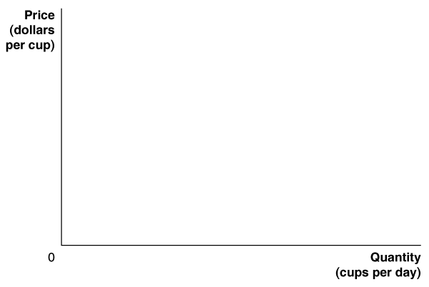
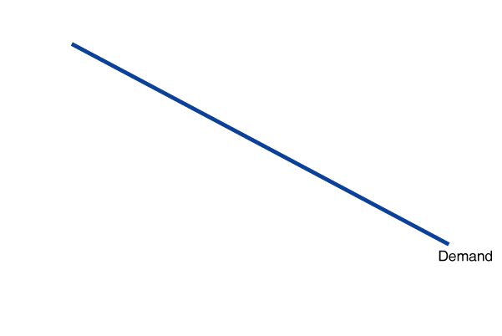
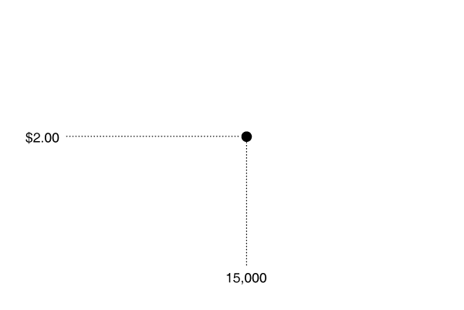
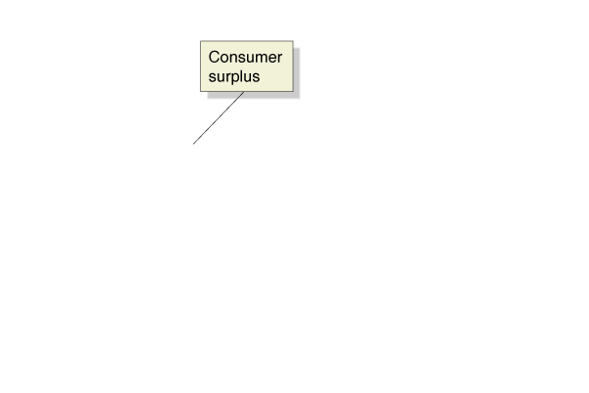
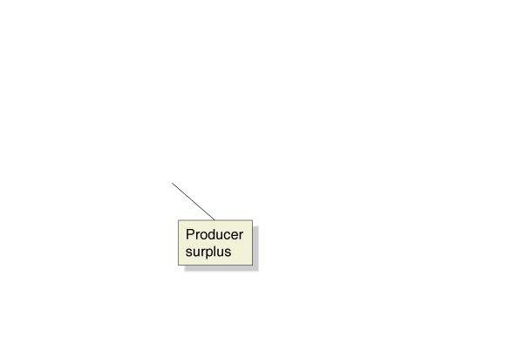
The Efficiency of Competitive Equilibrium—Surplus
At the competitive equilibrium quantity, the economic surplus (CS + PS) is also maximized!
Our two concepts of economic efficiency result in the same level of output.
Notes:
The economic surplus in a market is the
sum of the blue area, representing consumer
surplus, and the red area, representing producer
surplus.

Slide 6
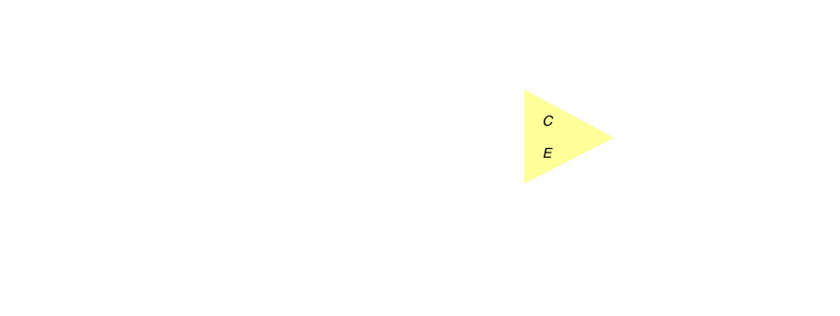


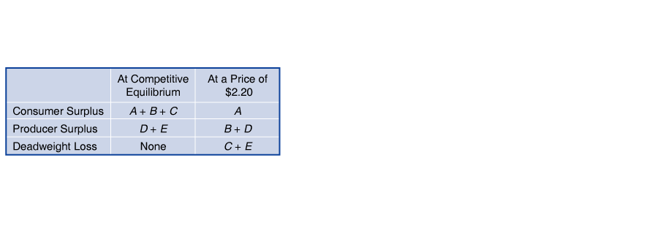
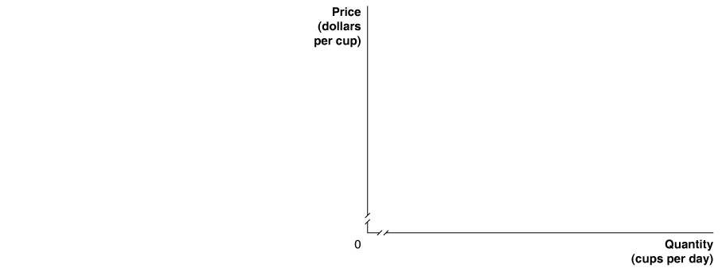
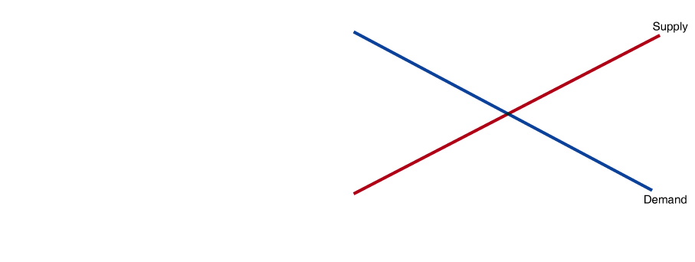
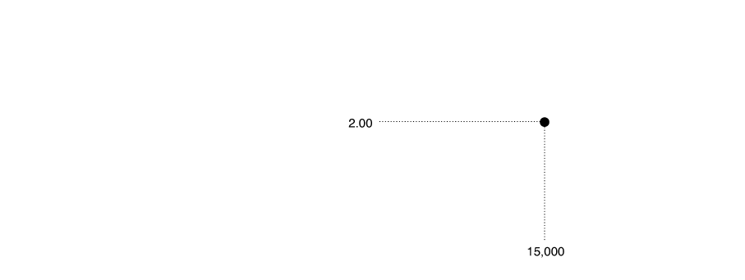
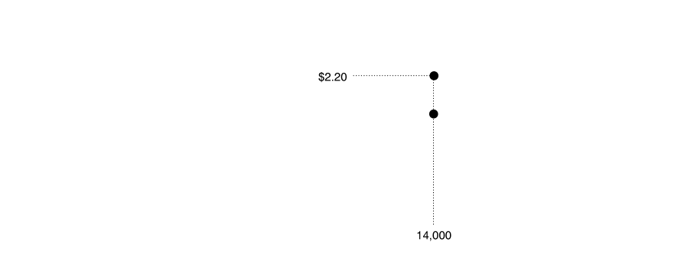
Economic Surplus if the Market is Not in Equilibrium
Deadweight Loss (DWL): The amount of inefficiency in a market.
In competitive equilibrium, deadweight loss is zero.

Slide 7
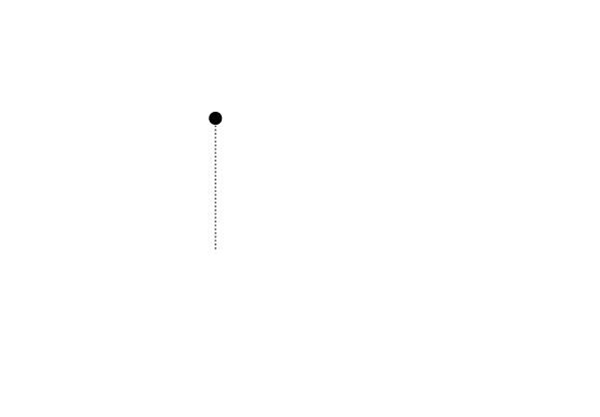


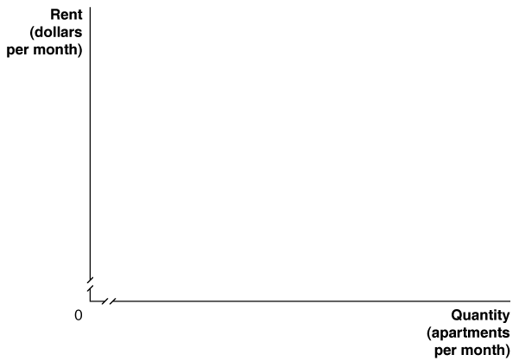
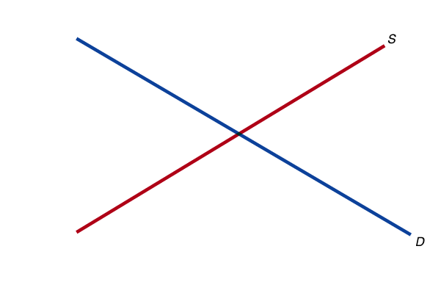
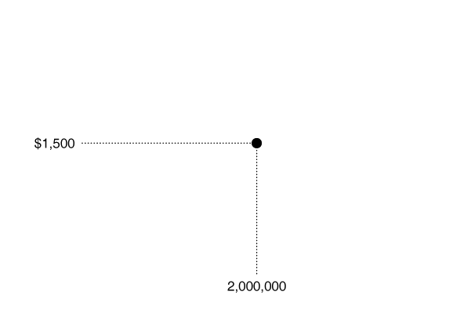
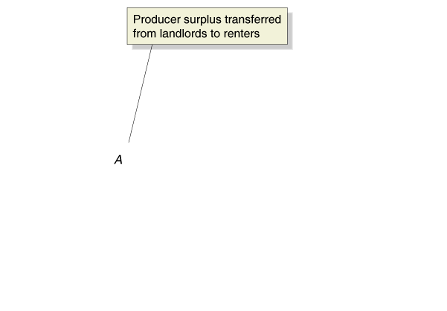
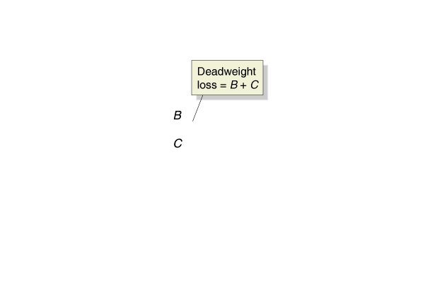
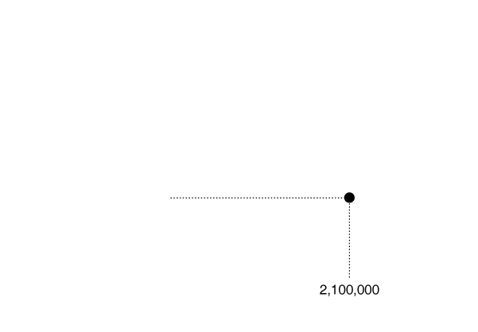
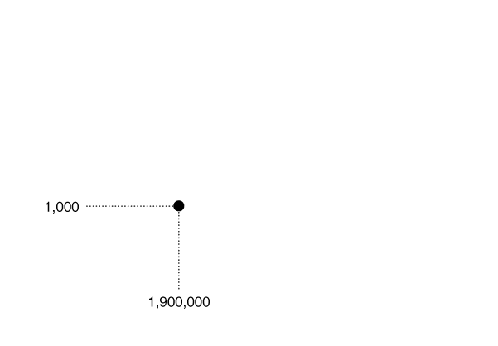
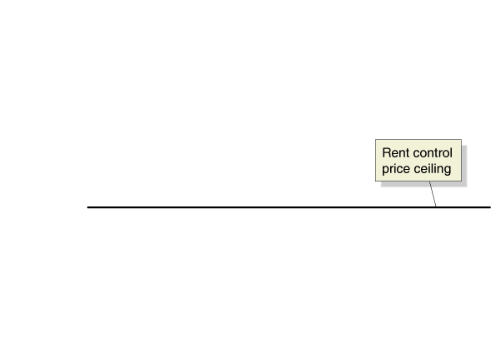
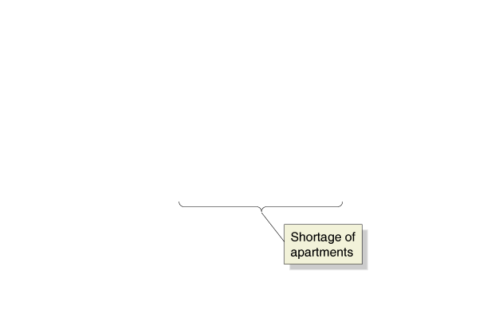
What about Rent Control?
Producer surplus equal to the area of the blue rectangle A is transferred from landlords to renters.
There is a deadweight loss equal to the areas of yellow triangles B and C.

Slide 8
Market Equilibrium and Efficiency
The market equilibrium is the point that maximizes total well-being (total surplus) of all participants in the market.
Price ($)
Suppose the price increases from the equilibrium price of $200 to $300.
Reduction in cameras sold by 10 million.
Reduces consumer surplus.
Reduces producer surplus.
600
Producer surplus
500
Consumer surplus
Prices
above
market
400
equilibrium reduce
1
total surplus.
S
300
2
4
200
5
3
100
D
0
5
10
15
20
25
30
35
40
45
50
55
60
65
Quantity of cameras (millions)
Notes:
It should be noted that there are two effects going on that change consumer and producer surplus:
A change in price. A redistribution of surplus from consumers to producers (no change in total surplus).
- This is zero-sum. What consumers lose, producers gain.
A change in quantity. Net decline in total surplus.
- This is not zero-sum. Consumers and producers are worse off!

Slide 9
Market Equilibrium and Efficiency
Lowering the price from the market equilibrium price decreases total surplus.
Suppose the price decreases from the equilibrium price of $200 to $100.
Reduction in cameras sold by 15 million.
Reduces consumer and producer surplus.
Dead weight loss is areas 4 and 5.
Price ($)
600
Producer surplus
Consumer surplus
500
Deadweight loss
Prices
below
market
400
equilibrium reduce
total surplus.
S
300
1
4
200
5
2
100
3
D
0
5
10
15
20
25
30
35
40
45
50
55
60
65
Quantity of cameras (millions)
Notes:
This slide simply labels deadweight loss. The next slide goes into more detail. When a market is efficient, there is no exchange that can make anyone better off without someone becoming worse off. Efficiency is one of the most powerful features of a market system and is achieved without centralized coordination.

Slide 10
Changing the Distribution of Total Surplus
When an artificial price is imposed on a market, surplus is transferred between consumers and producers.
Price ($)
Price ($)
600
600
500
500
400
400
1
S
S
300
300
1
2
4
4
200
5
200
5
3
2
100
100
3
D
D
0
5
10
15
20
25
30
35
40
45
50
0
5
10
15
20
25
30
35
40
45
50
Quantity of cameras (millions)
Quantity of cameras (millions)
Notes:
While there is also a deadweight loss of areas 4 and 5, the change in distribution is isolated in this analysis. It should be clear that the above redistribution is a zero-sum game. That is, whatever consumer surplus is lost in the left figure, producers gain, and whatever producer surplus is lost in the right figure, consumers gain. The analysis of the deadweight loss is provided on the next slide.

Slide 11
Calculating Change in Total Surplus
Use the following graph to calculate the difference in total surplus if the price increases from $200 to $300.
When price is $200
CS = $4.5 B and PS = $3B
Total surplus = $7.5B
When price is $300
CS = ½ × 20M × ($500 - $300) = $2B
PS = ($300-$133)x20m+ ½ ($133)x20m
Total surplus = $2B + $4.67B = $6.67B
The change in total surplus is equal to $6.67B - $7.5B = -$0.83B
Price ($)
600
500
400
1
S
300
2
4
200
5
133.33
3
100
D
0
5
10
15
20
25
30
35
40
45
50
55
60
65
Quantity of cameras (millions)
Notes:
Consumer surplus gets smaller (from areas 1,2, and 4 to area 1). The area of triangle 1 is CS = ½*20M*($500-$300) = $2B. Producer surplus gets larger (from area 3 and 5 to areas 2 and 3).

Slide 12
Deadweight Loss
When an artificial price is imposed on a market, a deadweight loss occurs.
The deadweight loss is the loss of total surplus that results when the quantity of a good that is bought and sold is below the market equilibrium quantity.
Reduction in cameras sold by 10 million.
Reduces consumer and producer surplus.
Deadweight loss is the gray triangle.
Price ($)
600
500
400
Deadweight loss
S
300
200
Transactions
that no longer
take place at the
100
new price
D
0
5
10
15
20
25
30
35
40
45
50
55
60
65
Quantity of cameras (millions)

Slide 13
Why Intervene?
There are three reasons why a government may step in and intervene in a market:
Correcting market failures or missing markets.
Changing the distribution of benefits.
Encouraging or discouraging consumption of certain goods.
Notes:
Correcting market failures. Our model of demand and supply has so far assumed that markets work efficiently—but in the real world, that’s not always true. For example, sometimes there is only one producer of a good, who faces no competition and can charge an inefficiently high price. Other times, one person’s use of a product or service imposes costs on other people that are not captured in prices paid by the first person, such as the pollution caused by burning the gas in your car. Situations in which the assumption of efficient, competitive markets fails to hold are called market failures. When there is a market failure, intervening can actually increase total surplus.
Changing the distribution of surplus. Efficient markets maximize total surplus, but an efficient outcome may still be seen as unfair. For example, even if the job market is efficient, wages can still drop so low that some workers fall below the poverty line while their employers make healthy profits. The government might respond by intervening in the labor market to impose a minimum wage. This policy will change the distribution of surplus, reducing employers’ profits and lifting workers’ incomes. Reasonable people can—and often do—argue about whether a policy that benefits a certain group (such as minimum-wage workers) is justified or not. Our focus will be on accurately describing the benefits and costs of such policies.
Encouraging or discouraging consumption. Around the world, many people judge certain products to be “good” or “bad” based on culture, health, religion, or other values. At the extreme, certain “bad” products are banned altogether, such as hard drugs. More often, governments use taxes to discourage people from consuming bad products without banning them altogether. Common examples are cigarettes and alcohol; many governments tax them heavily, with the aim of reducing smoking and drinking. In some cases, minimizing costs imposed on others (such as from pollution or secondhand smoke) is also part of the motivation for discouraging consumption. On the other hand, governments use subsidies to encourage people to consume “good” products or services. For instance, many governments provide public funding for schools to encourage education and for vaccinations to encourage parents to protect their children against disease.

Slide 14
Price Controls
Price controls can be divided into categories:
Price ceiling: A maximum legal price at which a good can be sold.
Typically placed on essential goods and services such as food, gasoline, and electricity.
Price floor: A minimum legal price at which a good can be sold.
Typically placed on agricultural goods that are risky to produce.

Slide 15
Price Ceilings
Suppose the Mexican government imposes a price ceiling on tortillas. What effect does this have on the market?
Price ($/lb.)
Price ($ / lb.)
1.25
1.25
Producers supply
1.00
S
1.00
a lower quantity.
S
0.75
0.75
Consumers demand
0.50
0.50
a higher quantity.
0.25
0.25
Price
ceiling
Shortage
D
D
0
25
50
75
100
0
25
50
75
100
Quantity of tortillas (millions of lbs.)
Quantity of tortillas (millions of lbs.)
Notes:
The left panel illustrates a hypothetical market for tortillas without a price ceiling. The equilibrium price is $0.50 per pound, and the equilibrium quantity is 50 million pounds. Let’s say that the government of Mexico responded to rising tortilla prices by setting a price ceiling of approximately $0.25 per pound, as shown in the right panel. When price falls, consumers will want to buy more tortillas. In this example, the price fell from $0.50 to $0.25, and as a result, quantity demanded increased from 50 million to 75 million pounds. A lower price means fewer producers will be willing to sell tortillas. When the price fell to $0.25, the quantity supplied dropped from 50 million to 25 million pounds. A lower price means higher quantity demanded, but lower quantity supplied. Supply and demand were no longer in equilibrium. The price ceiling created a shortage of tortillas, equal to the 50 million pound difference between the quantities supplied and demanded.

Slide 16
Price Ceilings
Did the price ceiling meet the goal of providing low-priced tortillas to consumers?
Yes. Consumers were able to buy some tortillas at the low price of $0.25 a pound.
No. Consumers wanted to buy three times as many tortillas as producers were willing to supply.
How did the price ceiling affect welfare?

Slide 17

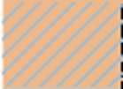
Welfare Effects of a Price Ceiling
Reduction in tortillas sold by 25 million.
Deadweight loss occurs.
Transfer of surplus from producers to consumers.
Price ($/lb.)
Producer surplus
1.25
Consumer surplus
Deadweight loss
1.00
S
0.75
0.50
1
2
0.25
Price
ceiling
D
0
25
50
75
100
Quantity of tortillas (millions of lbs.)
Notes:
It should be clear that a price ceiling causes:
Total welfare (or surplus) to decrease.
Producer surplus to fall.
3) Consumer surplus to either increase or decrease. Whether consumer surplus increases or decreases depends on the whether the deadweight loss is smaller or larger than the transfer. (Or, in this example, whether area 1 is larger or smaller than area 2.)

Slide 18
Welfare Effects of a Price Ceiling
Are price ceilings worth the decrease in total surplus?
Because a price ceiling causes a shortage, goods must be rationed. But how?
Rationed equally.
First-come, first-served basis.
Rationed to those who are given preference
→Shortages cause people to engage in rent-seeking behavior, such as bribing whoever is in charge of allocating scarce supplies.

Slide 19
Price Floors
Suppose the U.S. government imposes a price floor on milk. What effect does this have on the market?
Price ($/gal.)
Price ($/gal.)
4.50
4.50
4.00
S
4.00
S
3.50
3.50
Excess supply
3.00
3.00
Price floor
2.50
2.50
2.00
2.00
1.50
1.50
1.00
D
1.00
D
0.50
0.50
0
5
1
0
1
5
2
0
2
5
3
0
3
5
0
5
1
0
1
5
2
0
2
5
3
0
3
5
Quantity of milk (billions of gals.)
Quantity of milk (billions of gals.)
Notes:
The United States has maintained price floors for dairy products for over 60 years; the Milk Price Support Program began with the Agricultural Act of 1949.

Slide 20
Price Floors
Did the price floor meet the goal of providing support to producers?
Yes. Producers were able to sell some milk at a higher price of $3.00 per gallon.
No. Some producers may not be able to sell all of their milk because demand no longer meets supply.
How did the price floor affect welfare?

Slide 21


Welfare Effects of a Price Floor
Reduction in milk sold by 5 million gallons.
Deadweight loss occurs (Area 1).
Transfer of surplus (Area 2) from consumers to producers.
Producer surplus
Price ($/gal.)
Consumer surplus
4.50
Deadweight loss
S
4.00
3.50
3.00
Price
2
floor
2.50
1
2.00
1.50
1.00
0.50
D
0
5
10
15
20
25
30
35
Quantity of milk (billions of gals.)
Notes:
It should be clear that a price floor causes:
Total welfare (or surplus) to decrease.
Consumer surplus to fall.
Producer surplus to increase or decrease. Whether producer surplus increases or decreases depends on whether the deadweight loss is smaller than the transfer. (Or, in this example, whether area 1 is larger or smaller than area 2.)

Slide 22
Welfare Effects of a Price Floor
Are price floors worth the decrease in total surplus?
One way to answer is through studying how much excess milk will the government have to buy.
The answer is the entire amount of excess supply created by the price floor.
In the above case, 10 billion gallons will be purchased at $3 per gallon.
The cost to maintain the price floor is then $30 billion.
What happens to the excess milk?

